Slide 1
Transient Heat Conduction in Nuclear Fuel Pin
Presentation By
(2022UCS0106) Rishabh Raj
(2022UCS0092) Hitesh Choudhary

Slide 2
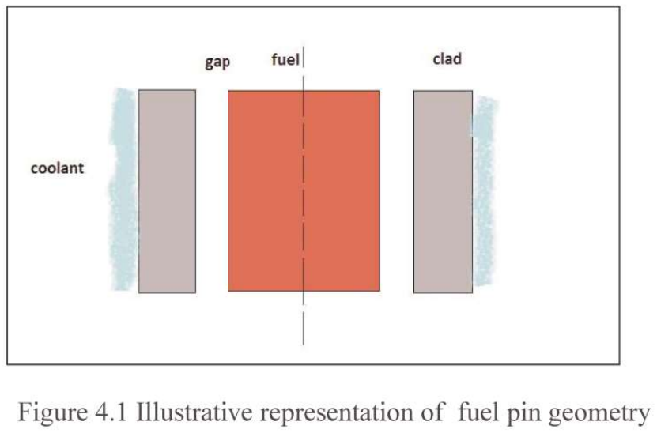
Radial Heat conduction in nuclear fuel elements
Reactor fuel pin is a cylindrical fuel element that contain fuel pellet, gap and cladding as shown in Figure 4.1. Coolant can be in single phase or two phase. Fuel and clad properties are available as a function of temperature. The state of the coolant is obtained from convection equations. Thus, the information is provided by these to transient conduction solver. As the equation is non-linear due to complex property and boundary conditions, numerical solutions are called for

Slide 3
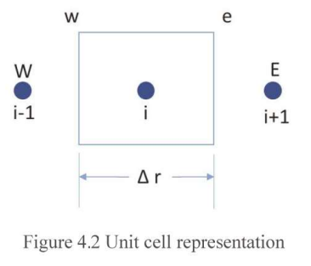
Discretized equations for fuel pin geometry (using finite volume approach)
In this section, the governing equation (shown in the previous slide) is integrated over volume and time at node_{i} to obtain the discretized equations.

Slide 4
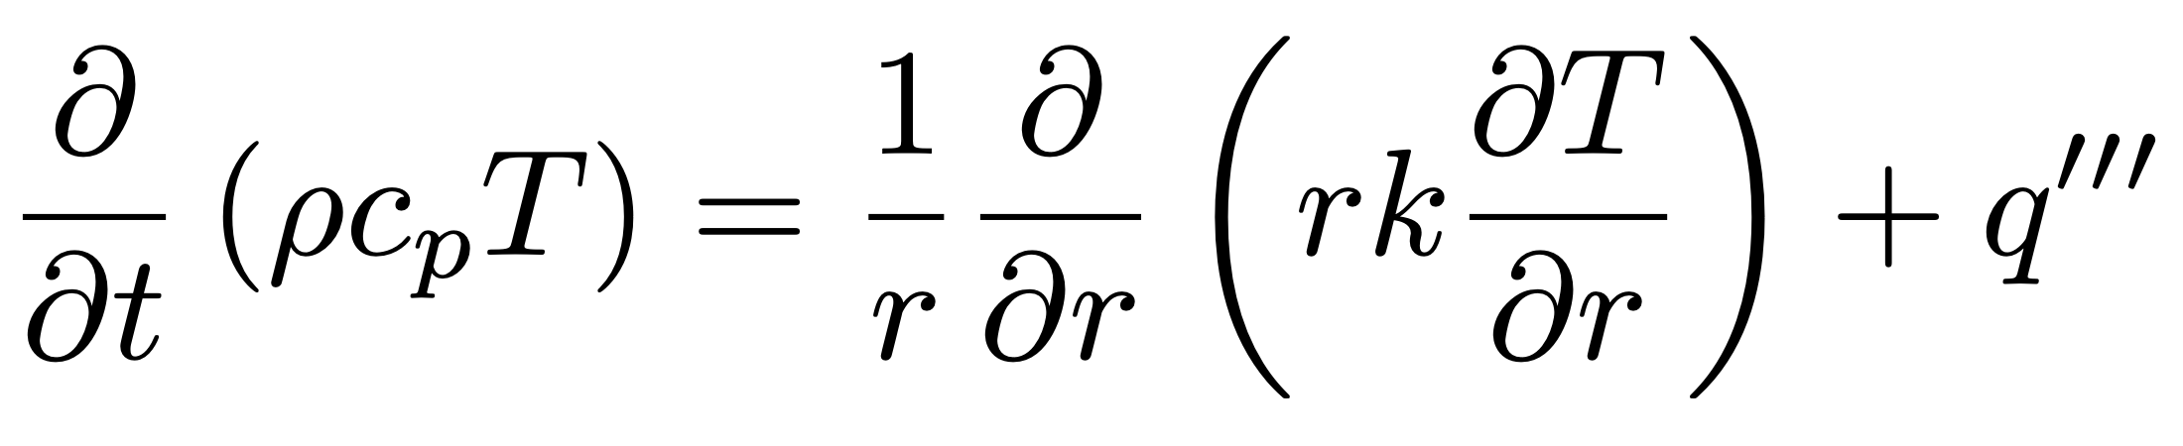
Basic governing equation (after Over assumption of azimuthal symmetry and neglecting axial conduction affects )

Slide 5
Transient term
$$∫_{w}^{e}∫_{t}^{t+Δt}\frac{∂}{∂t}\left(ρc_{p}T\right)rdrdt=Δr_{i}r_{i}[(ρc_{p}T_{i}^{n+1})-(ρc_{p}T_{i}^{n})]$$
T_{i}^{n+1} T_{i+1}^{n} represents average values in the control volume at n+1th and n^{th} timesteps at i^{th} node location.

Slide 6
Conduction term
$$∫_{w}^{e}∫_{t}^{t+Δt}(1/r)\frac{∂}{∂t}\left(rk\frac{∂}{∂r}\left(T\right)\right)rdrdt=\left(\left(\frac{r_{i+1}^{n+1}k_{i+1}^{n+1}}{Δr_{i+1}^{n+1}}\left(T_{i+1}^{n+1}-T_{i}^{n+1}\right)\right)-\left(\frac{r_{i-1}^{n+1}k_{i-1}^{n+1}}{Δr_{i-1}^{n+1}}\left(T_{i}^{n+1}-T_{i-1}^{n+1}\right)\right)\right)$$
T_{i}^{n+1} T_{i+1}^{n} represents average values in the control volume at n+1th and n^{th} timesteps at i^{th} node location.

Slide 7
Heat Generation Term
$$∫_{w}^{e}∫_{t}^{t+Δt}q^{{}^{′′′}}rdrdt=(q_{i}^{{}^{′′′}})^{n+1}Δt\left(\frac{r_{i+1}^{2}-r_{i-1}^{2}}{2}\right)=(q_{i}^{{}^{′′′}})^{n+1}r_{i}Δr_{i}Δt$$
T_{i}^{n+1} T_{i+1}^{n} represents average values in the control volume at n+1th and n^{th} timesteps at i^{th} node location.

Slide 8
$$∫_{w}^{e}∫_{t}^{t+Δt}\frac{∂}{∂t}\left(ρc_{p}T\right)rdrdt=Ψ\left(∫_{w}^{e}∫_{t}^{t+Δt}(1/r)\frac{∂}{∂t}\left(rk\frac{∂}{∂r}\left(T\right)\right)rdrdt-∫_{w}^{e}∫_{t}^{t+Δt}q^{{}^{′′′}}rdrdt\right)$$
$${\left(\frac{Δr_{i}r_{i}ρC_{p}}{Δt}\right)}^{n+1}(T_{i}^{n+1})-{\left(\frac{Δr_{i}r_{i}ρC_{p}}{Δt}\right)}^{n}(T_{i}^{n})=Ψ\left(\frac{r_{i+1}^{n+1}k_{i+1}^{n+1}}{Δr_{i+1}^{n+1}}T_{i+1}^{n+1}\right)+Ψ\left(\frac{r_{i-1}^{n+1}k_{i-1}^{n+1}}{Δr_{i-1}^{n+1}}T_{i-1}^{n+1}\right)-Ψ\left(\left(\frac{r_{i+1}^{n+1}k_{i+1}^{n+1}}{Δr_{i+1}^{n+1}}+\frac{r_{i-1}^{n+1}k_{i-1}^{n+1}}{Δr_{i-1}^{n+1}}\right)T_{i}^{n+1}\right)+Ψ(q_{i}^{{}^{′′′}})^{n+1}r_{i}Δr_{i}$$
$$\left(\left(Ψ\frac{r_{i+1}^{n+1}k_{i+1}^{n+1}}{Δr_{i+1}^{n+1}}+Ψ\frac{r_{i-1}^{n+1}k_{i-1}^{n+1}}{Δr_{i-1}^{n+1}}+{\left(\frac{Δr_{i}r_{i}ρC_{p}}{Δt}\right)}^{n+1}\right)T_{i}^{n+1}\right)=Ψ\left(\frac{r_{i+1}^{n+1}k_{i+1}^{n+1}}{Δr_{i+1}^{n+1}}T_{i+1}^{n+1}\right)+Ψ\left(\frac{r_{i-1}^{n+1}k_{i-1}^{n+1}}{Δr_{i-1}^{n+1}}T_{i-1}^{n+1}\right)+Ψ(q_{i}^{{}^{′′′}})^{n+1}r_{i}Δr_{i}+{\left(\frac{Δr_{i}r_{i}ρC_{p}}{Δt}\right)}^{n}(T_{i}^{n})$$
Final Equation
$$[CAP^{n+1}]T_{i}^{n+1}=[CAW^{n+1}]T_{i+1}^{n+1}+[CAE^{n+1}]T_{i-1}^{n+1}+S^{n+1}$$

Slide 9
Final Equation
$$[CAP^{n+1}]T_{i}^{n+1}=[CAW^{n+1}]T_{i+1}^{n+1}+[CAE^{n+1}]T_{i-1}^{n+1}+[S^{n+1}]$$
$$AT={\left(\frac{Δr_{i}r_{i}ρC_{p}}{Δt}\right)}^{n+1}$$
$$AW^{n+1}=\frac{r_{i-1}^{n+1}k_{i-1}^{n+1}}{Δr_{i-1}^{n+1}}$$
$$CAW^{n+1}=ΨAW^{n+1}$$
$$ATO={\left(\frac{Δr_{i}r_{i}ρC_{p}}{Δt}\right)}^{n}$$
$$AE^{n+1}=\frac{r_{i+1}^{n+1}k_{i+1}^{n+1}}{Δr_{i+1}^{n+1}}$$
$$CAE^{n+1}=ΨAE^{n+1}$$
$$AQ^{n+1}=(q_{i}^{{}^{′′′}})^{n+1}r_{i}Δr_{i}$$
$$CAQ^{n+1}=ΨAQ^{n+1}$$
$$Ψ=\text{Implicit factor}$$
$$CAP^{n+1}=CAW^{n+1}+CAE^{n+1}+AT$$
$$S^{n+1}=CAQ^{n+1}+ATO⋅T^{n}$$

Slide 10
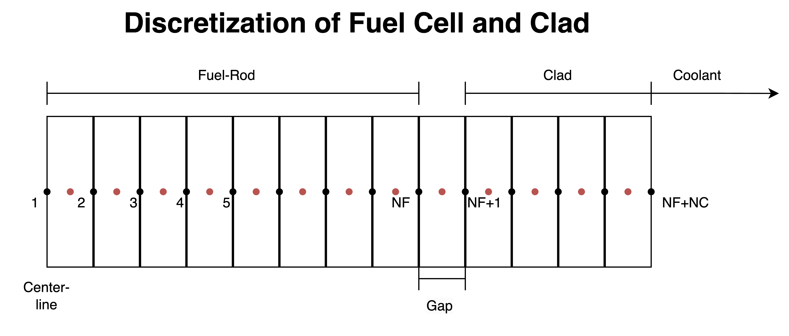
$$T_{inf}$$
$$T_{1}$$
$$T_{NF+NC}$$
NF =no. of fuel-cell divisions
NC =no. of clad-divisions
NT=NF+NC

Slide 11
Boundary Conditions
At Centre-line in Fuel Rod(Nuemann Left Boundary Condition)
$$CAW_{1}^{n+1}=0$$
$$S_{1}^{n+1}=CAQ_{1}^{n+1}+ATO_{1}⋅T_{1}^{n}+Ψ⋅r_{1}⋅q_{flux}$$
Q-flux = Heat flux
At Fuel-Gap Surface(Robin’s Right Boundary Condition)
$$CAE_{NF}^{n+1}=ΨAE_{NF}^{n+1}+Ψ⋅r_{NF}⋅HTC$$
HTC = Heat-Transfer Coefficient for fuel-gap-clad
$$CAP_{NF}^{n+1}=CAW_{NF}^{n+1}+CAE_{NF}^{n+1}+AT_{NF}+Ψ⋅r_{NF}⋅HTC$$
$$S_{NF}^{n+1}=CAQ_{NF}^{n+1}+ATO_{NF}⋅T_{NF}^{n}+Ψ⋅r_{NF}⋅HTC⋅\left(\frac{T_{NF}^{n}+T_{NF+1}^{n}}{2}\right)$$

Slide 12
At Gap-Clad Surface(Robin’s Left Boundary Condition)
$$CAW_{NF+1}^{n+1}=ΨAW_{NF+1}^{n+1}+Ψ⋅r_{NF+1}⋅HTC$$
$$CAP_{NF+1}^{n+1}=CAW_{NF+1}^{n+1}+CAE_{NF+1}^{n+1}+AT_{NF+1}+Ψ⋅r_{NF+1}⋅HTC$$
$$S_{NF+1}^{n+1}=CAQ_{NF+1}^{n+1}+ATO_{NF+1}⋅T_{NF+1}^{n}+Ψ⋅r_{NF+1}⋅HTC⋅\left(\frac{T_{NF}^{n}+T_{NF+1}^{n}}{2}\right)$$
At Clad-Coolant Surface(Robin’s Right Boundary Condition)
HTCC = Heat-Transfer Coefficient for clad-coolant
Tinf = Temperature of Coolant
$$CAE_{NF+NC}^{n+1}=0$$
$$CAP_{NF+NC}^{n+1}=CAW_{NF+NC}^{n+1}+CAE_{NF+NC}^{n+1}+AT_{NF+NC}+Ψ⋅r_{NF}⋅HTCC$$
$$S_{NF+NC}^{n+1}=CAQ_{NF+NC}^{n+1}+ATO_{NF+NC}⋅T_{NF+NC}^{n}+Ψ⋅r_{NF+NC}⋅HTCC⋅T_{inf}$$

Slide 14
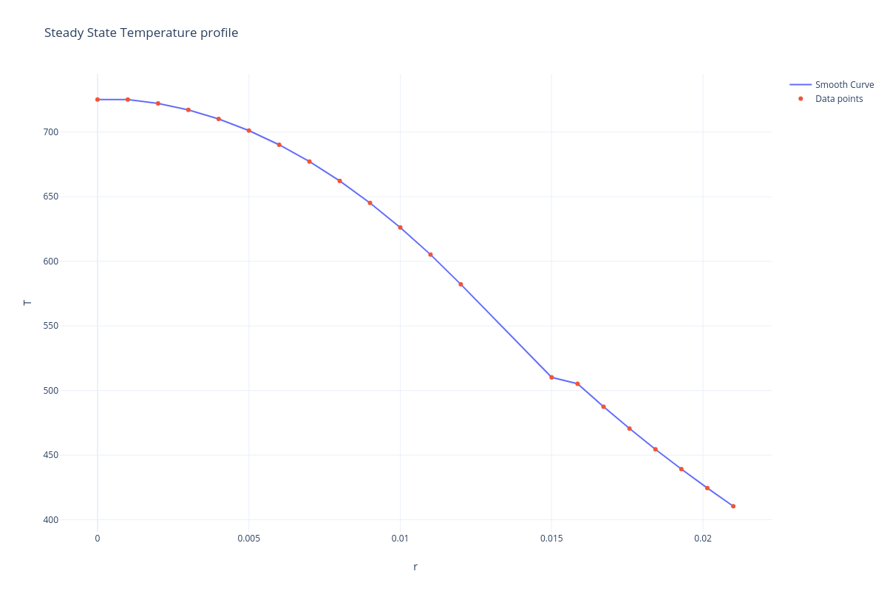
Steady State Temperature Profile

Slide 15
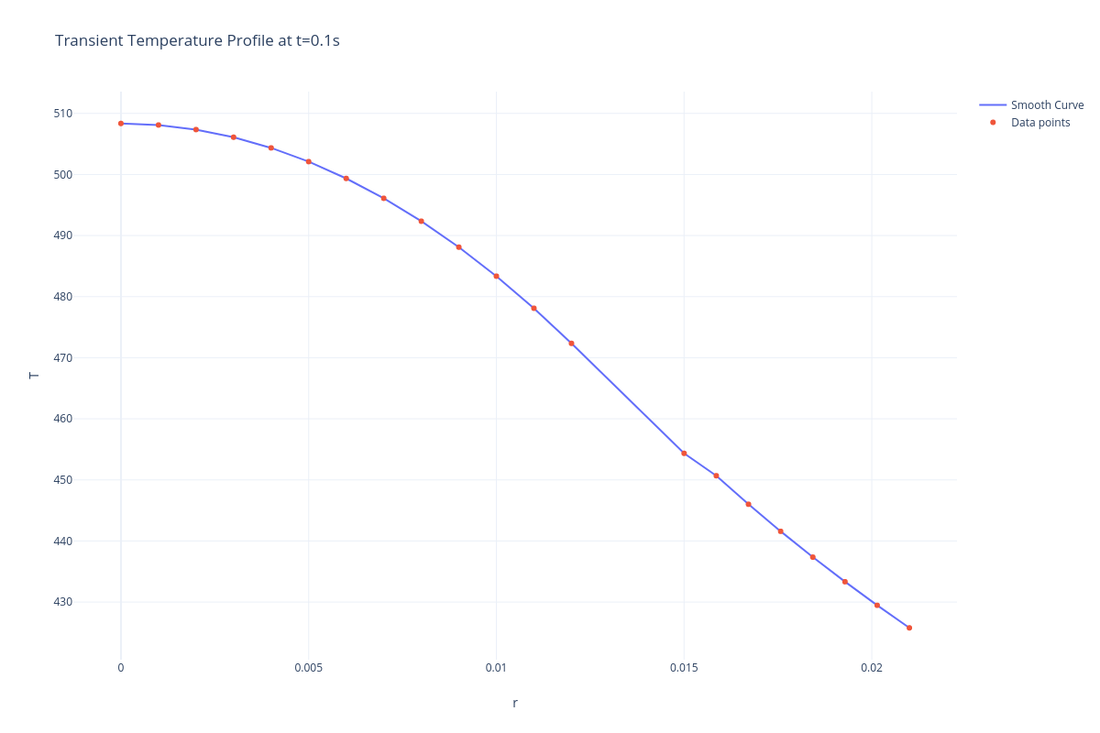
Transient Profile at t=0.1s

Slide 16

Transient Profile at t=0.3s

Slide 17

Transient Profile at t=0.5s

